Slide 1
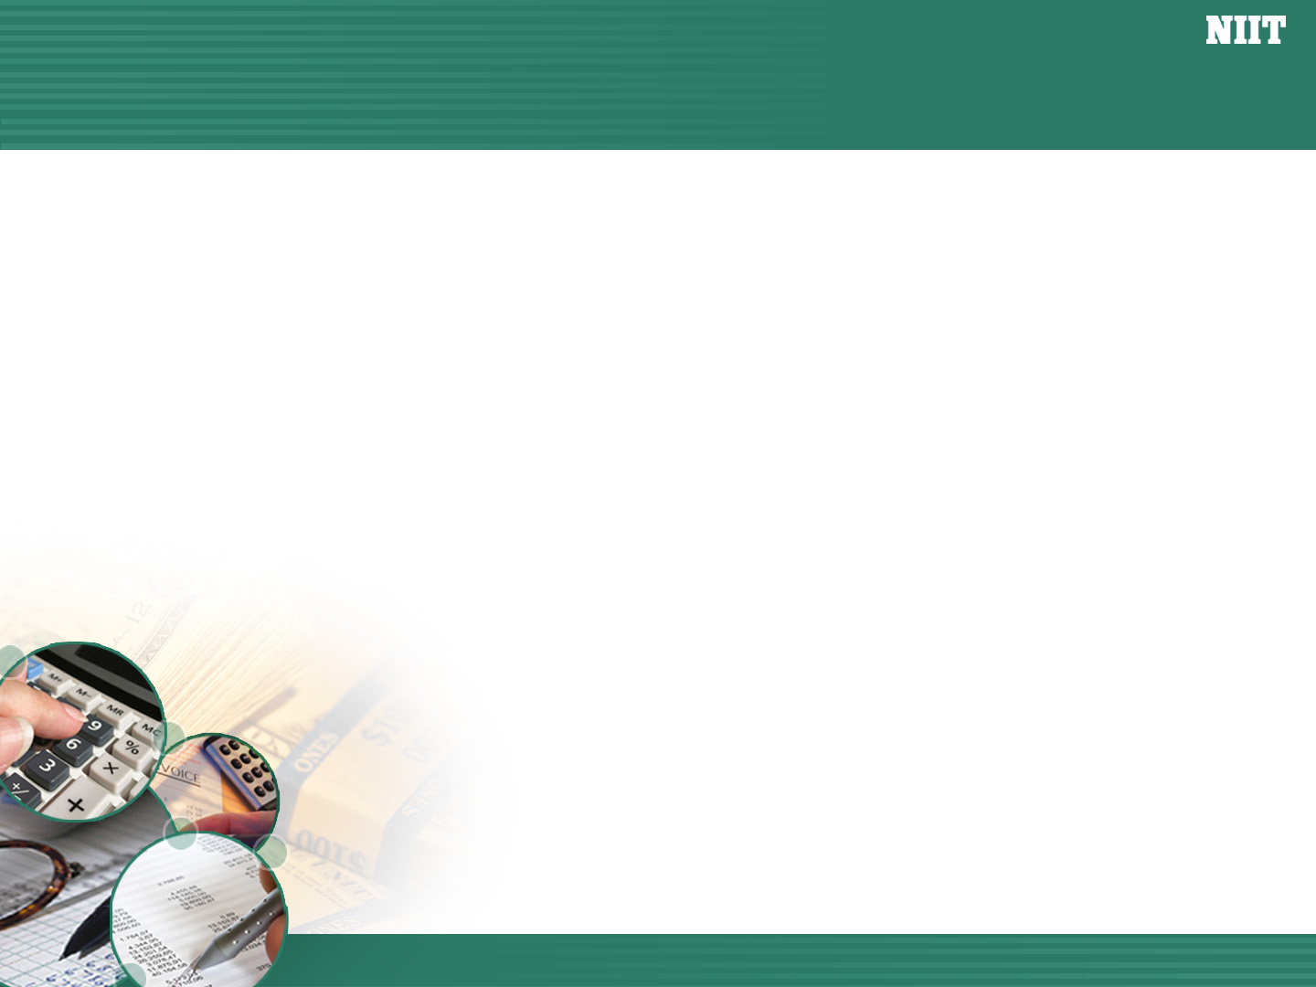
Objectives
In this session, you will learn to:
  Create and maintain budgets and scenarios
  Generate and print various reports
Notes:
Share the session objectives with the students.

Slide 2
Budgets and Controls
Budgeting:
  Is used to control the expenditure.
  Is the process of creating budgets and comparing the budgeted figures against the actual figures.
  Tally.ERP 9 allows you to:
    Create multiple budgets
    Maintain budgets for specific purposes

Slide 3

Demo: Activating Budgets and Controls
Let us see how to activate Budgets and Controls in Tally.ERP 9.
Notes:
You need to perform the steps given under the following topic:
6.7 Budgets & Controls (page 74)

Slide 4
Demo: Creating a Group Budget
Let us see how to create a Group Budget in Tally.ERP 9.
Notes:
You need to perform the steps given under the following topic:
6.7.1 Creating a Group Budget (page 75)

Slide 5
Display Budgets and Variances for Group Budget
Display Budgets and Variances for Group Budget:
  Budgets:
    Can be displayed in new columns in the Balance Sheets and Profit and Loss Account.

Slide 6
Demo: Displaying Budgets and Variances for Group Budget
Let us see how to view the report displaying the Budget values and the variances for that Budget in Tally.ERP 9.
Notes:
You need to perform the steps given under the following topic:
6.7.2 Display Budgets and Variances for Group Budget (page 77)

Slide 7
Demo: Altering a Budget
Let us see how to alter a budget in Tally.ERP 9.
Notes:
You need to perform the steps given under the following topic:
6.7.3 Altering a Budget (page 79)

Slide 8
Demo: Deleting a Budget
Let us see how to delete a budget in Tally.ERP 9.
Notes:
You need to perform the steps given under the following topic:
6.7.4 Deleting a Budget (page 79)

Slide 9
Demo: Creating a Ledger Budget
Problem Statement:
  Create a new Budget – Corporate Budget (Ledger) for the period 1-4-2009 to 31-3-2010.

Slide 10
Demo: Creating a Ledger Budget (Contd.)
Let us see how to create a new corporate budget in Tally.ERP 9.
Notes:
You need to perform the steps given under the following topic:
6.7.5 Creating a Ledger Budget (page 79)

Slide 11
Demo: Display Budgets and Variances for Ledger Budget
Let us see how to display Budgets and Variances for Ledger Budget in Tally.ERP 9.
Notes:
You need to perform the steps given under the following topic:
6.7.6 Display Budgets and Variances for Ledger Budget (page 80)

Slide 12
Scenario Management
A scenario is an imagined sequence of events.
Scenario Management:
  Is an effective management tool in Tally.ERP 9.
  Enables comparison of actual as well as projected provisional figures of accounts related information.
  Generates reports with provisional figures as the entries are actually not passed through the main books of accounts.
  Forecasts by entering forecast figures in provisional vouchers and including them to get forecasted figures.

Slide 13
Scenario Management (Contd.)
To include the provisional or forecasted transactions, Tally.ERP 9 provides:
  Reversing Journal vouchers:
    Reverses the effect in the books of accounts one day after the specified date.
  Memorandum vouchers:
    Are used for making suspense payments and when items are sent for approval.
  Optional vouchers:
    Any voucher can be converted into optional voucher and be used for recording.

Slide 14
Scenario Management (Contd.)
  Optional vouchers, Memo Vouchers and Reversing Journal Vouchers are recorded in Exception reports in Tally.ERP 9.

Slide 15
Demo: Creating a Scenario
Let us see how to create a Scenario in Tally.ERP 9.
Notes:
You need to perform the steps given under the following topic:
6.8.1 Creating a Scenario (page 85)

Slide 16
Demo: Altering a Scenario
Let us see how to alter a Scenario in Tally.ERP 9.
Notes:
You need to perform the steps given under the following topic:
6.8.2 Altering a Scenario (page 91)

Slide 17
Demo: Deleting a Scenario
Let us see how to delete a Scenario.
Notes:
You need to perform the steps given under the following topic:
6.8.3 Deleting a Scenario (page 91)

Slide 18
Order Processing
Order Processing:
  Is the process of placing orders with suppliers for a purchase to be made from them or receive orders from customers for the purpose of selling.
  Is linked to inventories.
  Allows to:
    Track the order position of a stock item.
    Know whether the goods ordered have arrived or not.
    Know whether the orders have been delivered on time and reasons for the delay if any.

Slide 19
Order Processing (Contd.)
The Purchase order or sales order once created can be altered.
The details of any pending purchase or sales orders can be obtained from Order details screen.
Cost centre allocation can also be done for purchase or sales orders.
By specifying the order number the purchase or sales order can be linked to the purchase or sales invoice by selecting the order number.

Slide 20
Demo: Activating Order Processing
Let us see how to activate
Order Processing feature in Tally.ERP 9.
Notes:
You need to perform the steps given under the following topic:
7.1 Order Processing (page 94)

Slide 21
Demo: Purchase Order Processing
Problem Statement:
  Raise a Purchase Order on 15-12-2009 on Navketan Bricks (vide Order No. 1) for 5,000 pcs of Bricks @ Rs.3 /brick. (Godown - Warehouse). The due date is 26-12-2009 and additional Freight charges @ 3% is applicable. Orders do not affect financial records nor do they update inventories. In this section, set the Tracking Numbers to Not Applicable.

Slide 22
Demo: Purchase Order Processing (Contd.)
Let us see how to create Purchase Order in Tally.ERP 9.
Notes:
You need to perform the steps given under the following topic:
7.1.1 Purchase Order Processing (page 94)

Slide 23
Demo: Altering Purchase Order
Let us see how to alter a Purchase Order in Tally.ERP 9.
Notes:
You need to perform the steps given under the following topic:
7.1.2 Altering a Purchase Order (page 95)

Slide 24
Demo: Sales Order Processing
Problem Statement:
  Enter a Sales Order on 16-12-2009 on WinLab Technologies (vide Order No. WT/5) for 4,000 pcs (godown - Warehouse) of Bricks @ Rs. 5 /brick. The due date is 27-12-2009 and tax @ 17.5% is applicable.

Slide 25
Demo: Sales Order Processing (Contd.)
Let us see how to create Sales Order in Tally.ERP 9.
Notes:
You need to perform the steps given under the following topic:
7.1.3 Order Processing (page 94)

Slide 26
Demo: Altering a Sales Order
Let us see how to alter a Sales Order in Tally.ERP 9.
Notes:
You need to perform the steps given under the following topic:
7.1.4 Altering a Sales Order (page 97)

Slide 27
Demo: Displaying Order Position
Let us view the order position to know the amount of stock that is in the process of order both inward and outward.
Notes:
You need to perform the steps given under the following topic:
7.1.5 Display Order Position (page 97)

Slide 28
Demo: Display Columnar Orders and Stock Details
Let us see how to view Columnar Orders and Stock Details in Tally.ERP 9.
Notes:
You need to perform the steps given under the following topic:
7.1.6 Display Columnar Orders & Stock Details (page 99)

Slide 29
Adjusting Orders
Orders are adjusted at the time of raising delivery notes and invoices.

Slide 30
Demo: Adjusting Orders
Let us see how to adjust orders in Tally.ERP 9.
Notes:
You need to perform the steps given under the following topic:
7.1.7 Adjusting Orders (page 100)

Slide 31
Summary
In this session, you learned that:
  Budgets are used to control the expenditure. In Tally.ERP 9 budgets can be created for any account group, ledger and cost centre to generate a budget variance statement.
  Scenario reports are used for the comparison of actual as well as projected provisional figures of accounts related information.
  Order processing includes purchase and sales order processing. Here the details of purchase orders placed and sales orders received can be obtained.

